Slide 1
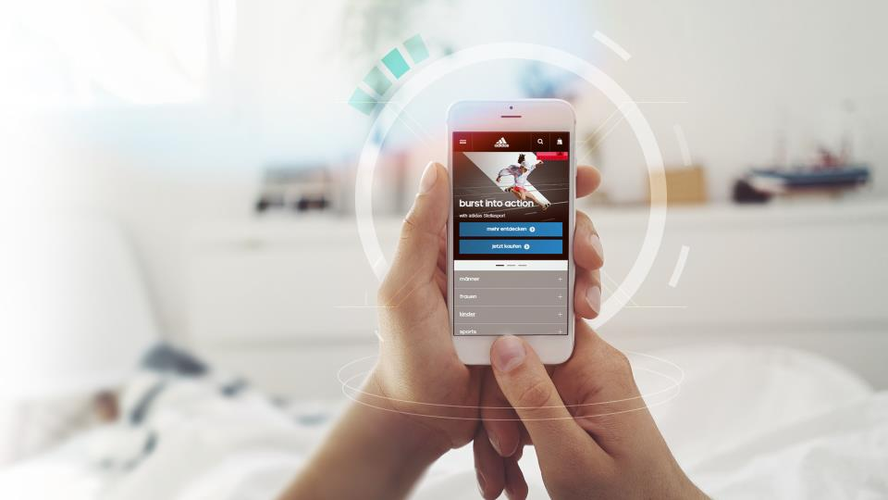
coding challenge

Slide 2
Architecture principles
At adidas, we care about serving consumers (in the sense of applications making use of our data and services) by serving more (high volume) , serving better (low latency) or serving more reliably(high resilience). In general, the topic of High Availability is very important to be ready for the future and deal with the current state with confidence.
In a nutshell, the basic architecture principles are:
Architect solutions in a way that makes them re-usable
Components are designed to scale based on incoming load.
Always care about data & IT security
All solutions should treat core operational database as a costly resource that needs to be used economically
Design for Failure – your solution has to assume and handle exception conditions

Slide 3
Architecture landscape aND REQUIREMENTS
PUBLIC Network zone
PUBLIC service
Expected SLA response time: 100 ms
Expected SLA monthly uptime 99,99%
Secure Network zone
SUBSCRIPTION service
SLA response time: 150ms
SLA monthly uptime 99.99%
?
Email service
SLA response time:: 60 secs
SLA monthly uptime 85%

Slide 4
mission statement
With the information given and additional assumptions of yours, you should develop an API for SUBSCRIPTIONs using the Java framework of your choice (ideally use Spring Boot) or NodeJS framework of your choice (preferably ExpressJS).
To create subscriptions a single endpoint will be created: in the public service.
Subscriptions contain: email, firstName, gender, dateOfBith, flag for consent and the newsletter Id corresponding to the campaign. Only gender and firstName are optional values. Rest of services receive the same parameters.
Services must be secure, only public service is accessible from the end user.
TIP: an example of a frontend application making use of this service would be similar to https://www.adidas.co.uk/on/demandware.store/Sites-adidas-GB-Site/en_GB/Newsletter-Subscribe
The subscription service has to persist the subscription and returns the ID of the created subscription to the public service.
To complete the subscription process, once the subscription was persisted by the subscription service, someway,, the email service will receive the required information to send an email to the user (take in account the SLAs to choose the best approach for this communication).

Slide 5
what we expect from you
Design the full solution that satisfy the SLAs..
Develop a piece of this application (maybe a microservice?), YOU DON’T NEED TO DEVELOP EVERYTHING.
Make that piece runnable in a container environment
Create a README.md explaining how to build/run/use the app, naming every framework/library you use and state what it does and why you used it.
Provide API documentation for the piece implemented using swagger, API Blueprint or similar.
Propose a team structure for this product and define the career development strategy
BONUS 1: Create 1 slide with a CI/CD pipeline proposal for the app.
BONUS 2: Design an architecture to deploy all services in a kubernetes cluster.
BONUS 3: Propose parameters to monitor, alerting structure and any other measures to ensure SLAs of the system you are building.
When you're done check in your solution into any public GIT repo hoster (github, bitbucket, etc.) and send us the link and any other documentation you want.

Slide 6
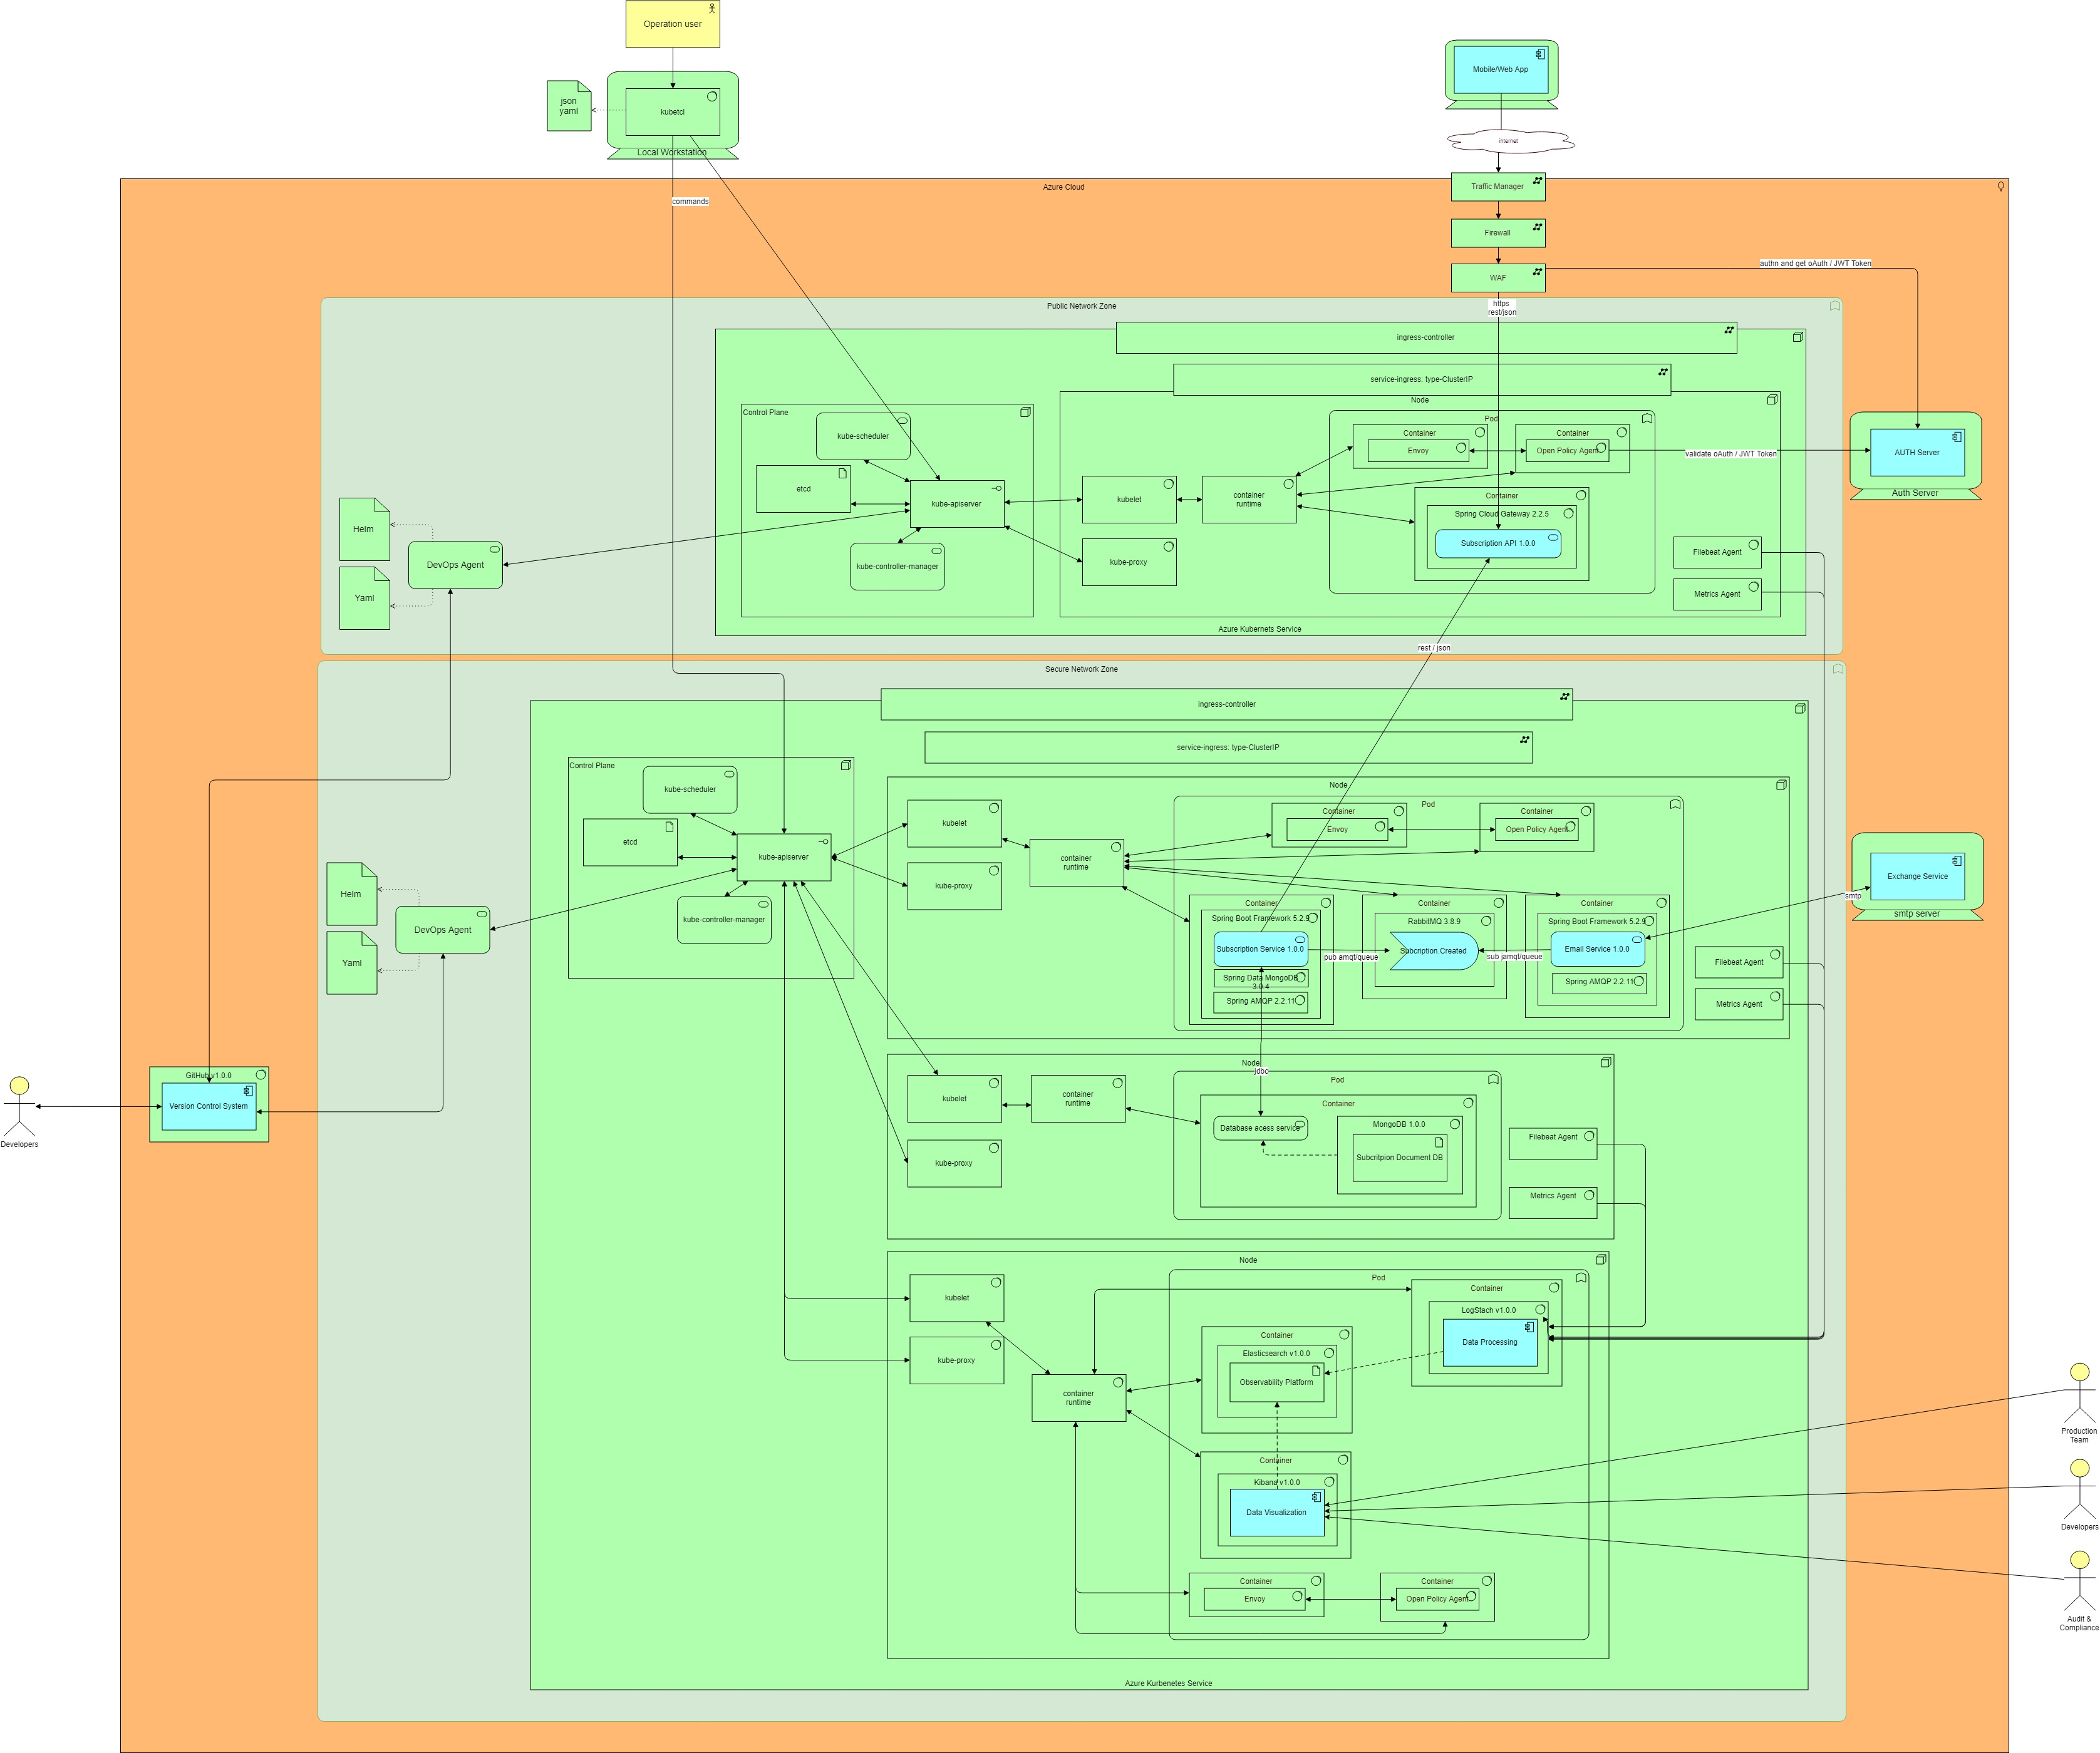
SOLUTION ARCHITECTURE

Slide 7
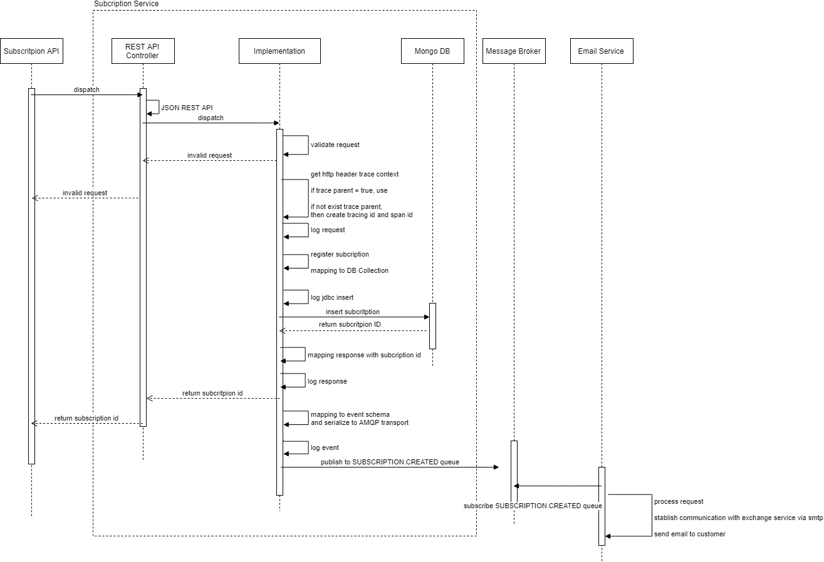
SOLUTION ARCHITECTURE

Slide 8
SOLUTION ARCHITECTURE
ASSUMPTIONS
Exist Identity Platform, who is capable to provide oAuth, JWT token
Exist an Exchange Service, capable to send email to final user/customer
Exist Git Repository, who’s version control system
Exist tools like SonarQube, Maven, Jenkins or Azure DevOps, capable to control complete CI/CD process: build, test, deploy and analyze code quality

Slide 9
SOLUTION ARCHITECTURE
APPLICATION AND TECHNICAL ARCHITECTURE
SUBSCRIPTION API v1.0.0: to be expose in the gateway with the follow url: https://fdqdn/SUBSCRIPTION/V1/CREATE. this api should be exposed in https, using rest/json
SUBSCRIPTION SERVICE v1.0.0: one method to be created and exposed as rest/json api - SUBSCRIPTION.1.0.0.CREATE ; the service should publish EVENT in the following queue subscription.PUB and Event Type: subscription.Created. the protocol to be used to communicate with message broker is amqp – queue.
Document database: to store all subscription. Document db because we don’t need relational db and can store all json document directly
EMAIL SERVICE: should subscribe EVENT in the following queue subscription.PUB and Event Type: subscription.created and communicate with exchange service to notify customer.
Observability platform: to observe what’s happen in the applications
For versioning: follow semantic version standard

Slide 10
SOLUTION ARCHITECTURE
APPLICATION AND TECHNICAL ARCHITECTURE
Spring boot framework: framework to code subscription service, email service
Spring amqp: provide development of AMQP-based messaging solutions.
RABBITMQ: message broker that provide amqp protocol. Used to create queue to pub and sub subscription email.
Spring cloud gateway: effective way to route to APIs and provide cross cutting concerns to them such as: security, monitoring/metrics, and resiliency.
Spring mongodb: to provides integration with the MongoDB document database
MONGODB: database selected to store subscription data.
Azure cloud: cloud provide

Slide 11
SOLUTION ARCHITECTURE
APPLICATION AND TECHNICAL ARCHITECTURE
Azure Kubernetes service: k8s Service provide by azure
Elasticsearch platform: fluent and metrics beat agents, Logstash, Elasticsearch and Kibana
Envoy: is a L7 proxy and communication bus designed for large modern service-oriented architectures. Used to interact with opa to validation policies
Open policy agent: policy engine that unifies policy enforcement across the stack. Used to provide global policies, like token validation and application policies according authorization needs.

Slide 12
SOLUTION ARCHITECTURE
Infrastructure ARCHITECTURE
2 different network zones:
Public network zone capable to receive requests from internet, with dedicated azure Kubernetes service (aks) to deploy in one node:
Deploy in one container spring cloud gateway to deploy subscription api
deploy in one container envoy
deploy in one container OPA. These container must be capable to communicate with Auth server
This node must contain also file beat and metrics agent to collect logs and metrics from stdout/stder files.

Slide 13
SOLUTION ARCHITECTURE
Infrastructure ARCHITECTURE
private network zone capable to receive requests only from aks deploy in public network zone. This private network will have:
dedicated azure Kubernetes service (aks) to deploy tree different nodes:
One node for services – subscription service and email services, in different containers. A container to deploy message broker – rabbitMq; a container to envoy and another container to deploy opa. This node must contain also file beat and metrics agent to collect logs and metrics from stdout/stder files.
One node for database to deploy mongodb. This node must contain also file beat and metrics agent to collect logs and metrics from stdout/stder files.
One node to deploy Elasticsearch platform: a container to Elasticsearch, a container to deploy logstach, a container to kibana, a container to envoy and another container to deploy opa.

Slide 14
SOLUTION ARCHITECTURE
Infrastructure ARCHITECTURE
Using azure cloud in one region will ensure high availability, because one region will have more than one data center – for example – region Amsterdam.
Sense this is a serious application, one region should be enough to answer the sla defined, but for business continuity, if a rto and rpo are defined as 4hours and 2hours, should be deploy another different region, like Dublin. Will have Amsterdam as primary and stablish a DR plan to Dublin region.

Slide 15
SOLUTION ARCHITECTURE
SUBSCRIPTION SERVICE DATA MODEL
METADATA THAT SHOULD BE COMMUN IN ALL SERVICE, TO IDENTIFY THE MESSAGE THAT’S RECEIVED AND RETURNED. IF ANY APPLICATIONAL ERROR, SHOULD BE RETURNED (DATA/STATUS), IF NOT RETURN HTTP CODE 200=OK
Follow w3C trace context standard for tracing: should be transported in http header, if not, should be created tracing id and send in each service metadata.
| traceParent (mandatory)
| traceState (optional)
| messageId (mandatory)
| messageCreatorId (mandatory)
| messageCreationTimestamp (mandatory)
input
METADATA
| status (optional)
| codes (mandatory)
| code (mandatory)
| description (mandatory)
| actor (mandatory)
| messageId (optional)
MESSAGE
output
| email (mandatory; string)
| firstName (optional; string)
| gender (mandatory; string)
| dateOfBirth (mandatory; date)
| flagConsent (mandatory; boolean)
| newsletterId (mandatory; string)
| subscriptionId (optional; string)
DATA
subscription

Slide 16
SOLUTION ARCHITECTURE
EVENT DATA MODEL PUBLISHED TO EMAIL SERVICE
METADATA THAT SHOULD BE COMMUN IN ALL EVENTS
CLOUDEVENTS STANDARD SHOULD BE USED
Follow w3C trace context standard for tracing: should be transported in http header, if not, should be created tracing id and send in each service metadata.
| eventId (mandatory)
| source (mandatory)
| eventType (mandatory)
| localEventType (optional)
| specVersion (mandatory)
| subject (optional)
| eventCreationTimestamp (optional)
| dataContextType (optional)
| dataContentEncoding (optional)
| schemaUrl (optional)
| traceParent (mandatory)
| traceState (optional)
| partitionkey (optional)
| samplingValue (optional)
| sequence (optional)
| sequenceType (optional)
| dataRef (optional)
METADATA
event
EVENT
| email (mandatory; string)
| firstName (optional; string)
| newsletterId (mandatory; string)
| consentFlag (mandatory; string)
DATA
subscription

Slide 17
SOLUTION ARCHITECTURE
OPEN POLICY AGENT
The Open Policy Agent (OPA) is an open source, general-purpose policy engine that unifies policy enforcement across the stack. OPA provides a high-level declarative language that let’s you specify policy as code and simple APIs to offload policy decision-making from your software. OPA will be used to enforce policies in microservices, Kubernetes, CI/CD pipelines, API gateways.
OPA (OPA-Envoy) that allows you to enforce OPA policies with Envoy, enforce fine-grained, context-aware access control policies with Envoy without modifying the service/microservice..
Envoy is a L7 proxy and communication bus designed for large modern service-oriented architectures. Envoy supports an External Authorization filter which calls an authorization service to check if the incoming request is authorized or not.

Slide 18
SOLUTION ARCHITECTURE
OPEN POLICY AGENT
IN addition to the Envoy sidecar, the application pods will include an OPA sidecar. When Envoy receives API requests destined for your microservice, it checks with OPA to decide if the request should be allowed.
POD
OPA
APPLICATION
4
3
MICROSERVICE
3.1 - OK
ENVOY
GLOBAL
2
1
1 – http request
2 – validate global policies (oAuth token validation)
3 – result fo global policies
4 – validate application policies (authorization for services)
3.1 – NOT OK
http server
CLIENT
BUNDLES

Slide 19
SOLUTION ARCHITECTURE
OPEN POLICY AGENT
GLOBAL POLICY:
TOKEN VALIDATION: Well Known Keys Endpoint, Require Expiration Time, Require Signed Tokens, Validate Audience, Validate Issuer, Validate Lifetime, Validate Issuer Signing Key, Validate Actor
Application policy
For subscription service a authorization policy must be create who authorize subscription api consume subscription service method create
For kibana user, should be create different authorization policies for each role: audit, operation, development, business. Each one should have access to different information.

Slide 20
SOLUTION ARCHITECTURE
User Access Control
For kibana users Should be define according following table:
Function | System | Profile | Role in the system | System permission
AUDITOR | OBSERVABILITY PLATFORM (ELASTICSEARCH / KIBANA) | AUDIT | AUDIT | FULL ACCESS TO ALL DATA STORE IN OBSERVABILITY PLATFORM
OPERATION TECHNICAN | OBSERVABILITY PLATFORM (ELASTICSEARCH / KIBANA) | OPERATION | OPERATION | FULL ACCESS TO ALL DATA STORE IN OBSERVABILITY PLATFORM
DEVELOPER | OBSERVABILITY PLATFORM (ELASTICSEARCH / KIBANA) | DEVELOPER | DEVELOPER | ACCESS ONLY TO HOT DATA AND SOME INFORMATION SHOULD BE ENCRYPTED, FOR SHORT TIME STABLISHED
SUBSCRIPTION PRODUCT OWNER | OBSERVABILITY PLATFORM (ELASTICSEARCH / KIBANA) | BUSINESS | BUSINESS | ACCESS ONLY TO HOT DATA AND SOME INFORMATION SHOULD BE ENCRYPTED

Slide 21
SOLUTION ARCHITECTURE
Authentication and Authorization
All authentication and authorization should be compliant and use OpenID Connect, oAuth token, JWT format. EACH front-end, that need to communicate with subscription api, should have client_id and client_secret and be authn in identity provider. This client_id and client_secret should be part of oauth token.
Data and communication Security
All Data should be encrypted in database, Credentials should be Encrypted
Data Retention: Minimum Retention
MINNIMUM Retention of audit data is based entirely on data retention policy. Optimally, log and transaction information will be kept for a minimum of 60 days past the designated audit requirements for the managed system; however, compliance requirements will vary based on the end applications being managed.
Maximum Retention Refer to above recommendation, optimally, log and transaction information will be kept maximum for 90 days past the designated audit requirements for the managed system.

Slide 22

SOLUTION ARCHITECTURE
Example 1
{
"Timestamp": 1586960586000,
"Attributes": {
"http.status_code": 500,
"http.url": "http://example.com",
"my.subscription.application.tag": "hello",
},
"Resource": {
"service.name": “subscription Service",
"service.version": "semver:1.0.0",
"k8s.pod.uid": "1138528c-c36e-11e9-a1a7-42010a800198",
},
"TraceId": "f4dbb3edd765f620",
"SpanId": "43222c2d51a7abe3",
"SeverityText": "INFO",
"SeverityNumber": 9,
“Name": “16677ttg8881898hhh",
“SourceId": “00001",
“SourceName": “SubscriptionFront-End",
"Body": "20200415T072306-0700 INFO I Subscription newsletter adidas campaign"
}
LOGGING
using of Open Telemetry standard. Metamodel:
Field Name | Description | Type | Required
Timestamp | Time when the event occurred. | Timestamp, uint64 | Y
TraceId | Request trace id. | byte sequence
SpanId | Request span id. | byte sequence
TraceFlags | W3C trace flag. | byte
SeverityText | The severity text (also known as log level). INFO|WARN|DEBUG|ERROR|TRACE|FATAL | string | Y
SeverityNumber | Numerical value of the severity. numerical value of the severity, normalized to values | number
Name | Short event identifier. | string | Y
SourceId | Unique Identifier of the origin of the request | string | Y
SourceName | Name of the origin of the request | string | Y
Body | The body of the log record. | any | Y
Resource | Describes the source of the log. | key/value pair list
Attributes | Additional information about the event. | key/value pair list

Slide 23
SOLUTION ARCHITECTURE
LOGGING
SOME POSSIBLE METRICS TO MONITOR SERVICES
| Resource: CPU, IO, Disk & Memory
| State: Shutdown, Processes, Clock Time
| Network: DNS, Latency, Packet Loss
infrastructure monitoring
| Total alert counts by service per week
| Time to resolution for alerts per service
| Noisy alerts by service per week (self-resolving)
| Top 20 most frequent alerts per week for each service.
alerting and on-call
METRICS
| Total count of incidents per week by SEV level
| Total count of SEVs per week by service
| MTTD, MTTR and MTBF for SEVs by service
high severity incident (SEV)
| Events
| Stack traces
| Context
| Breadcrumbs
application

Slide 24
SOLUTION ARCHITECTURE
LOGGING / METRICS
Metric | Description | When to alert?
Memory | JVM heap size needs to be less than node memory | Swap alert (128 to 256MB of swap)
Swap | swaps when swappiness is > 0 and the node doesn’t have enough memory to process the messages | Swap alert (128 to 256MB of swap)
Network | High network usage led to latency and performance degradation | Look for dropped packets in node interfaces (ethX)
Disk I/O | Measure Disk I/O performance on sequential reads and writes.
Disk usage | Measure logs disk for capacity | 85% raise alarm

Slide 25
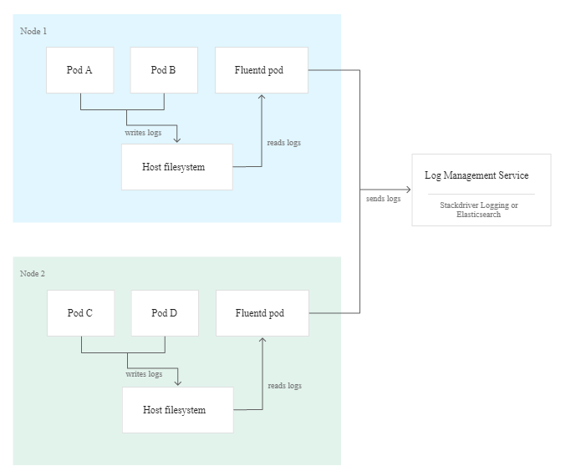
SOLUTION ARCHITECTURE
LOGGING
Containers offer an easy and standardized way to handle logs because you can write them to stdout and stderr. Docker captures these log lines and allows you to access them by using the docker logs command. As an application developer, you don't need to implement advanced logging mechanisms. Use the native logging mechanisms instead.

Slide 26
SOLUTION ARCHITECTURE
LOGGING
ELASTICKSEARCH PLATFORM: capable to Ingest logs into managed cluster and explore them in real time using the Logs app. Leverage File beat and Metric beat to send data from hosts, pods, and containers, and monitor them in the Metrics app.
FILEBEAT AND METRIC: used to collect data from pods and containers and sent to Logstash
LOGSTACH: receive data from collects and transform to Open Telemetry metamodel if necessary. The idea is, the application store logs in Open Telemetry format.
ELASTICHSEARCH: distributed engine to store log data.
KIBANA: different stakeholders (Audit, Operations, Developers, Business Areas) will use Kibana dashboards to analyze, monitor and manage. Capable also to create alerts.

Slide 27










CI/CD pipeline
INTEGRATION
TESTS
CHECKOUT
Build
Unit test
code analysis
DOCKER
Deploy
jar
Docker image
Developer PUSH code
to version control system
Docker image pull
Docker image push
Testing subscription api
DOCKER REGISTRY
1 REPOSITORY - SUBSCRIPTION SERVICE
1 repository – subscription api
1 Repository - opa policies

Slide 28
PRODUCT TEAM
Product Owner
Developer Manager
Developer
Developer
Business Analyst
Scrum Master
Developer
Quality Assurance
Solution Architect
Quality Assurance

Slide 29
PRODUCT TEAM
Career mapping
Self-assessment: engages with the employee to explore his or her knowledge, skills and abilities, as well as past experiences, accomplishments and interests.
Individualized career map. Creating an individualized career map involves identifying other positions within the organization that meet the employee's interests. The position may be a lateral move into a different job family or a promotion. In either case, the position should capitalize on the employee's past experiences, interests and motivation while at the same time requiring the employee to develop a certain degree of new knowledge, skills and abilities (KSAs) to give him or her something to work toward and stay engaged.
Exploring other opportunities. The final step in career mapping is to explore other job opportunities within the organization as they become available.
Attaining a mentor: A mentor can provide coaching, friendship, sponsorship, and role-modeling to the younger, less experienced protege

Slide 30
PRODUCT TEAM
MEMBER | Transversal Soft Skills | Innovation and Leadership SKILLS | Technical skills | Career path
PRODUCT OWNER | Communication skills Critical thinking and problem-solving skills Project management including detail orientation Management and supervisory skills | Innovation and Leadership Program | Domain knowledge | management positions 2-5 years
SCRUM MASTER | Communication skills Critical thinking and problem-solving skills. Project management including detail orientation. |  | AGILE SCRUM MASTER Software development understanding Domain knowledge | product owner 3-5 years
BUSINESS ANALYST | Communication skills Critical thinking and problem-solving skills Project management including detail orientation Management and supervisory skills |  | Software development understanding Domain knowledge Six Sigma BPMN Agile Business Analysis | product owner 3-5 years

Slide 31
PRODUCT TEAM
MEMBER | Transversal Soft Skills | Innovation and Leadership | Technical skills | Career path
DEVELOPERS | Communication skills Critical thinking and problem-solving skills. Project management including detail orientation. Management and supervisory skills. |  | Professional Cloud DEVELOPMENT Microservices Software Architecture: Patterns and Techniques Software development life cycle (SDLC) | SENIOR DEVELOPMENT 2-3 years DEVELOPMENT MANAGER 3-5 years
DEVELOPMENT MANAGER |  | Innovation and Leadership program |  | management positions 3-5 years
SOLUTION ARCHITECT | Communication skills. Critical thinking and problem-solving skills. Project management including detail orientation. Management and supervisory skills. | Innovation and Leadership program | Professional Cloud Solutions Architect togaf archimate Microservices Software Architecture: Patterns and Techniques | Lead solution architect 2-3 years ENTERPRISE ARCHITECT 2-5 years

Slide 32
PRODUCT TEAM
MEMBER | Transversal Soft Skills | Innovation and Leadership | Technical skills | Career path
Quality Assurance | Communication skills. Critical thinking and problem-solving skills. Project management including detail orientation. Management and supervisory skills. |  | DevOps Testing & Performance & Automation Software development life cycle (SDLC) | SENIOR QA 2-3 years QA MANAGER 3-5 years

